Slide 1
Operation dad
By Ben dunbar, Justin Hynes-Bruell, and bill wisheart

Slide 2
Outline
Introduction
Solution Approach
Inputs/Outputs
Conceptual Understanding
Experimental Results
Conclusion

Slide 3
Introduction to direction audio detection
Real time system that utilizes 2 microphones mounted on a wall to analyze sound waves and determine in which direction the sound originated from
Goal: Learn how to handle and compare two audio inputs while implementing skills gained from previous labs
Application: A security camera with a limited field of view could turn towards a source of sound

Slide 4
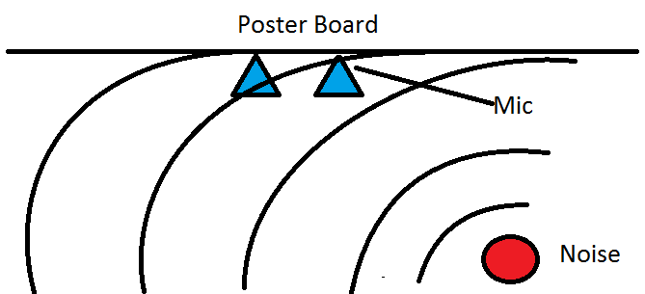
Solution Approach - Inputs
2 mics mounted to a PCB
Fixed distance apart (45 mm)

Slide 5
Solution approach - Processing

Slide 6
Solution approach - Outputs

Slide 7
Experimental Results

Slide 8
Conclusion

